Slide 1
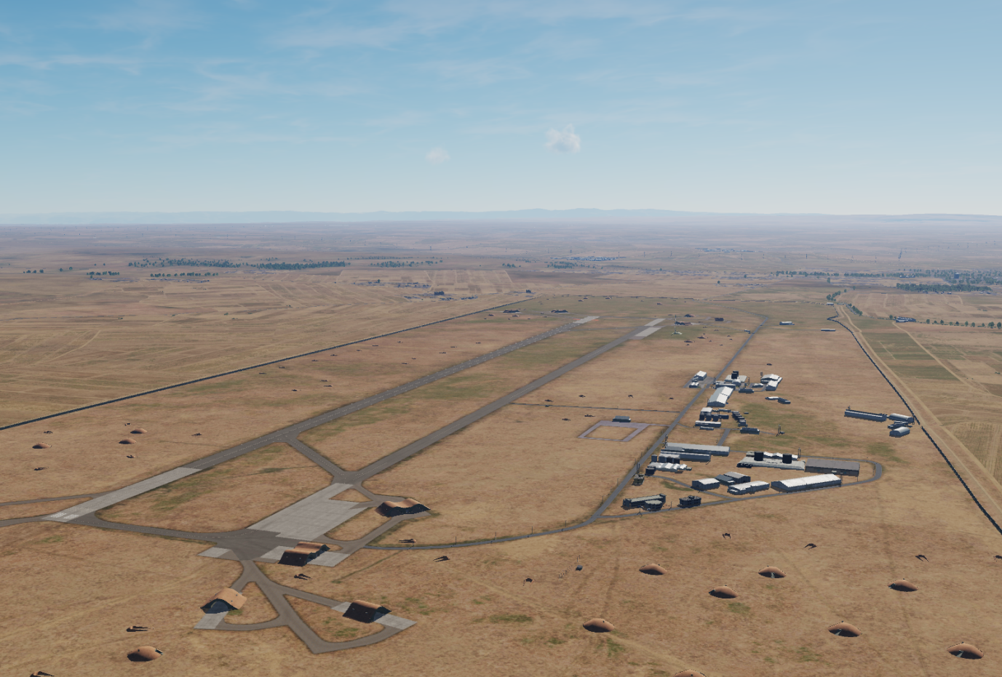

OPARTGT041 Abu al-Duhur Airbase
N
41
DESCRIPTION OF THE DESIRED POINTS OF IMPACT WITH WPN TYPE:
OPARTGT041A – Abu al-Duhur Airbase Runway
DPI 1 N35 43.935 E037 06.330/820ft/(500 Ibs bomb)
OPARTGT041B – Abu al-Duhur Airbase Taxiway
DPI 2 N35 44.074 E037 06.317/820ft/(500 Ibs bomb)
OPARTGT041C– Abu al-Duhur Airbase Hanger/Fuel/Maintenance Facilities
DPI 3 N35 44.295 E037 06.591/817ft/(500 Ibs bomb)
DPI’s relate to centre points of targets.
4
5
6
7
8

Slide 2
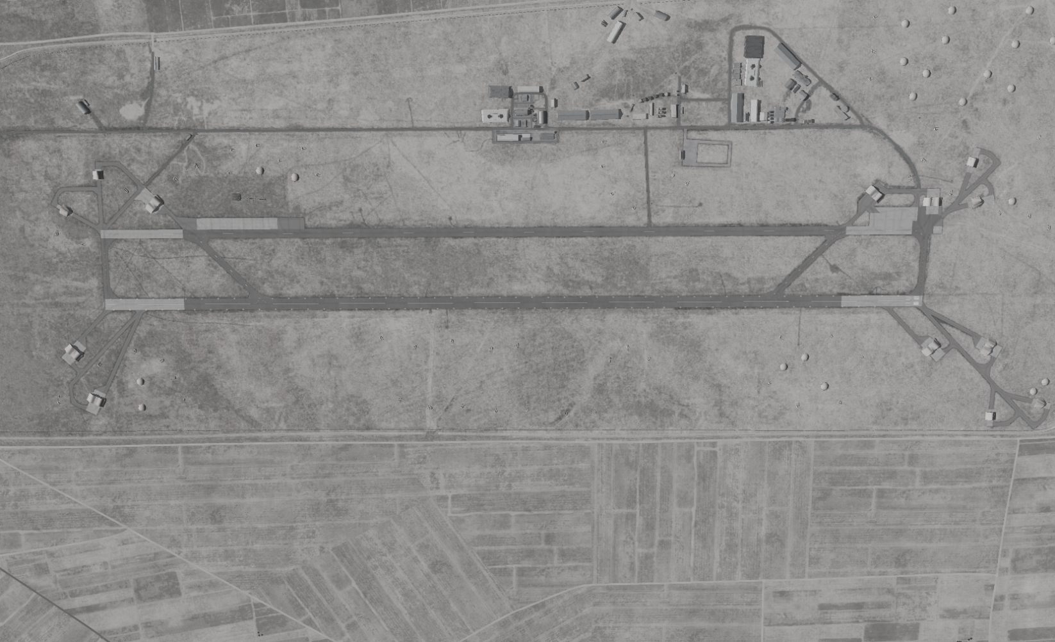
OPARTGT041 Abu al-Duhur Airbase
DPI’s relate to centre points of targets.
N
3
2
1
7
8

